Slide 1
Network layer (Part – I)

Slide 2
Topics to be discussed
Network layer design issues
Routing algorithms
  The Optimality Principal
  Shortest Path Routing
  Flooding
  Distance Vector Routing,
  Link state Routing,
  Hierarchical Routing,
  Broadcast Routing, Multicast Routing ,
  Routing for Mobile Hosts,
  Routing in Ad hoc Networks.

Slide 3
Network layer design issues:
Store and Forward packet Switching
Services Provided to the Transport Layer
Implementation of Connectionless Service
Implementation of Connection-Oriented Service
Virtual Circuit v/s Datagram Subnets;

Slide 4

Store and Forward packet Switching
The packet is stored there until it has fully arrived so the checksum can be verified. Then it is forwarded to the next router along the path until it reaches the destination host, where it is delivered.

Slide 5
Services Provided to the Transport Layer
The network layer services have been designed with the following goals in mind.
  The services should be independent of the router technology.
  The transport layer should be shielded from the number, type, and topology of the routers present.
  The network addresses made available to the transport layer should use a uniform numbering plan, even across LANs and WANs.

Slide 6
Services Provided to the Transport Layer
connection-oriented service or connectionless service ?
  If connectionless service :
    the subnet is unreliable
    packet ordering , error control and flow control should be performed by the hosts
    each packet must carry the full destination address
  Example: Internet (unreliable)

Slide 7
Services Provided to the Transport Layer
connection-oriented service or connectionless service ?
  If connection-oriented service
    the subnet is reliable
    packet ordering , error control and flow control should be performed by the subnet
    each packet contains a connection identifier
    quality of service is the dominant factor here.
  Example : ATM (reliable)

Slide 8
Implementation of Connectionless Service
If connectionless service is offered
  packets are injected into the subnet individually and routed independently of each other.
  packets are frequently called datagrams. and the subnet is called a datagram subnet
  No advance setup is needed.

Slide 9

Implementation of Connectionless Service
how a datagram subnet works ?
Each packet(1,2,3) is forwarded to C according to A's table.
For some reason, A decided to send packet 4 via a different route than that of the first three.

Slide 10
Implementation of Connection-Oriented Service
If connection-oriented service is used
  A path from the source router to the destination router must be established before any data packets can be sent.
  This connection is called a VC (virtual circuit), and the subnet is called a virtual-circuit subnet.

Slide 11

Implementation of Connection-Oriented Service
how a virtual-circuit subnet works ?
host H1 has established connection 1 with host H2.

Slide 12
Implementation of Connection-Oriented Service
how a virtual-circuit subnet works ?
The first line of A's table says that if a packet bearing connection identifier 1 comes in from H1, it is to be sent to router C and given connection identifier 1.
if H3 also wants to establish a connection to H2 , It chooses connection identifier 1 then we have a conflict .
A can easily distinguish connection 1 packets from H1 from connection 1 packets from H3, C cannot do this. So A assigns a different connection identifier to the outgoing traffic for the second connection.

Slide 13

Comparison of Virtual-Circuit and Datagram Subnets

Slide 14
Routing Algorithms

Slide 15
Routing Algorithms
The routing algorithm is that part of the network layer software responsible for deciding which output line an incoming packet should be transmitted on.
For datagram subnet, this decision must be made anew for every arriving data packet.
For virtual circuit subnet, this decision is made only when a new virtual circuit is being set up. (also called session routing )

Slide 16
Forwarding v/s Routing
  Routing
    making the decision which routes to use
    involves filling in and updating the routing tables.
  Forwarding :
    what happens when a packet arrives.
    looking up the outgoing line to use for it in the routing tables

Slide 17
Routing algorithm properties
  Correctness : Error free
  Simplicity : should be simple
  Robustness : coping with changes in the topology and traffic without requiring all jobs in all hosts to be aborted and the network to be rebooted every time some router crashes
  Stability : Should reach equilibrium and stay there. Under any condition the algorithm must not react slowly.
  Fairness: equally treating every node
  Optimality : Maximizing the flow
Contradictory goals

Slide 18
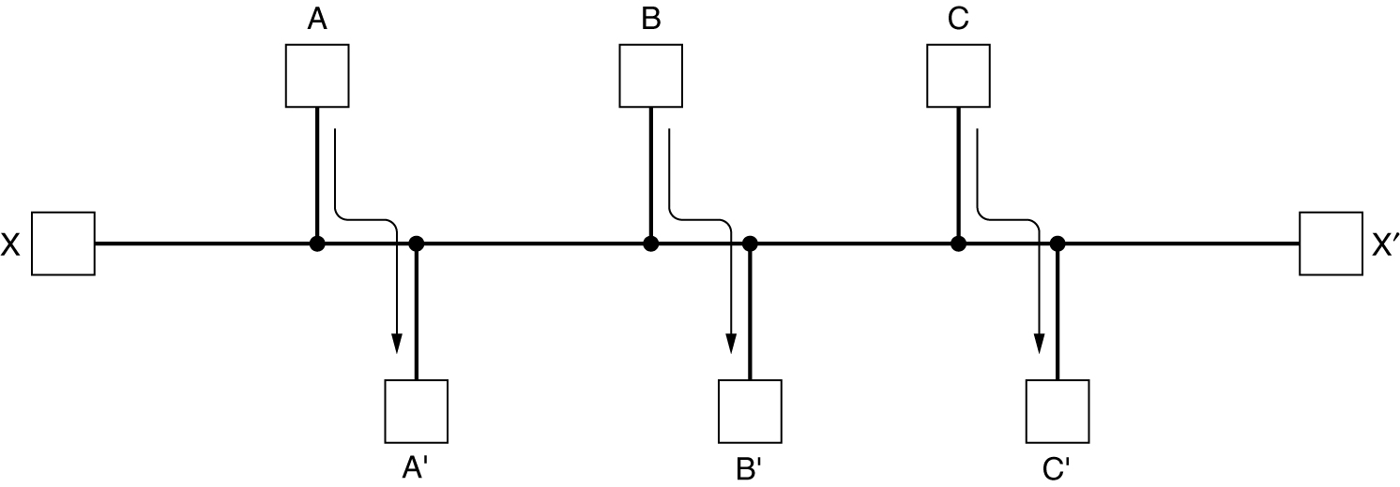
Routing algorithm properties
Conflict between fairness and optimality.
Is it fair to shut off the traffic between X and X’ to maximize the traffic between A and A’ , B and B’ and C and C’ ?

Slide 19
Two classes of Routing Algorithms
Nonadaptive algorithms (static routing)
  The choice of the route to use is computed in advance, off-line, and downloaded to the routers when the network is booted.
  Inability to react rapidly to network failures
Adaptive algorithms (dynamic routing)
  change their routing decisions to reflect changes in the topology, and usually the traffic as well.
  Added complexity

Slide 20
The Optimality Principle
“ It states that if router J is on the optimal path from router I to router K, then the optimal path from J to K also falls along the same route “
r1
r2
I
J
K
r3
H
If r2 is the optimal path from J to K , the optimal path from I to K is r1r2
If r3 is the optimal path from J to K , the optimal path from I to K is r1r3

Slide 21
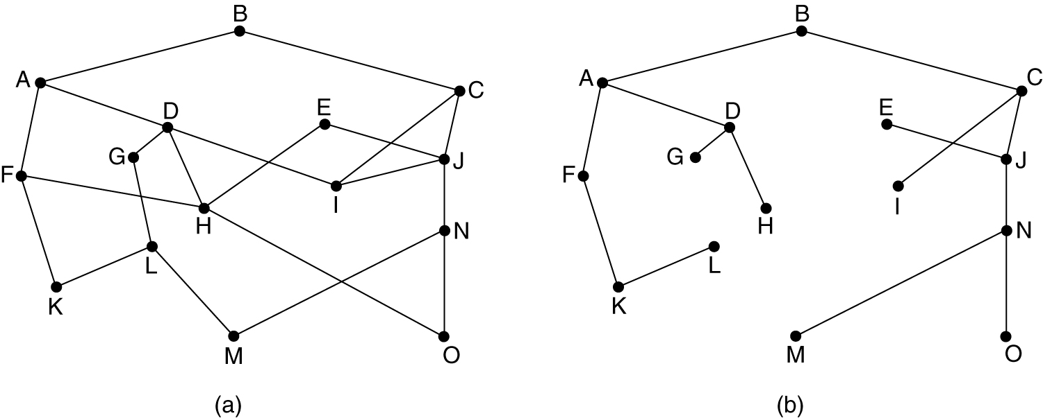
The Optimality Principle
The set of optimal routes from all sources to a given destination form a tree rooted at the destination. Such a tree is called a sink tree
(a) A subnet. (b) A sink tree for router B. (metric is no. of hops)

Slide 22
The Optimality Principle
Note :
  The goal of all routing algorithms is to discover and use the sink trees for all routers.
  Since a sink tree is indeed a tree, it does not contain any loops
  so each packet will be delivered within a finite and bounded number of hops

Slide 23
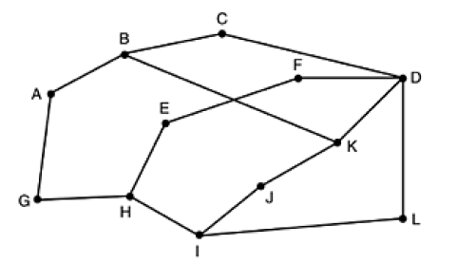
The Optimality Principle
Find a sink tree for the destination C. Assume that path distance metric is number of hops

Slide 24
Shortest Path Routing
(static algorithm)
Several algorithms for computing the shortest path between two nodes of a graph are known
Dijkstra’s algorithm (1959) is a Shortest Path Routing,
  A node is labeled with its distance from the source node along the best known path.
  Initially , all nodes are labeled with infinity, As the algorithm proceeds and paths are found, the labels may change, reflecting better paths
  When it is discovered that a label represents the shortest possible path from the source to that node, it is made permanent

Slide 25
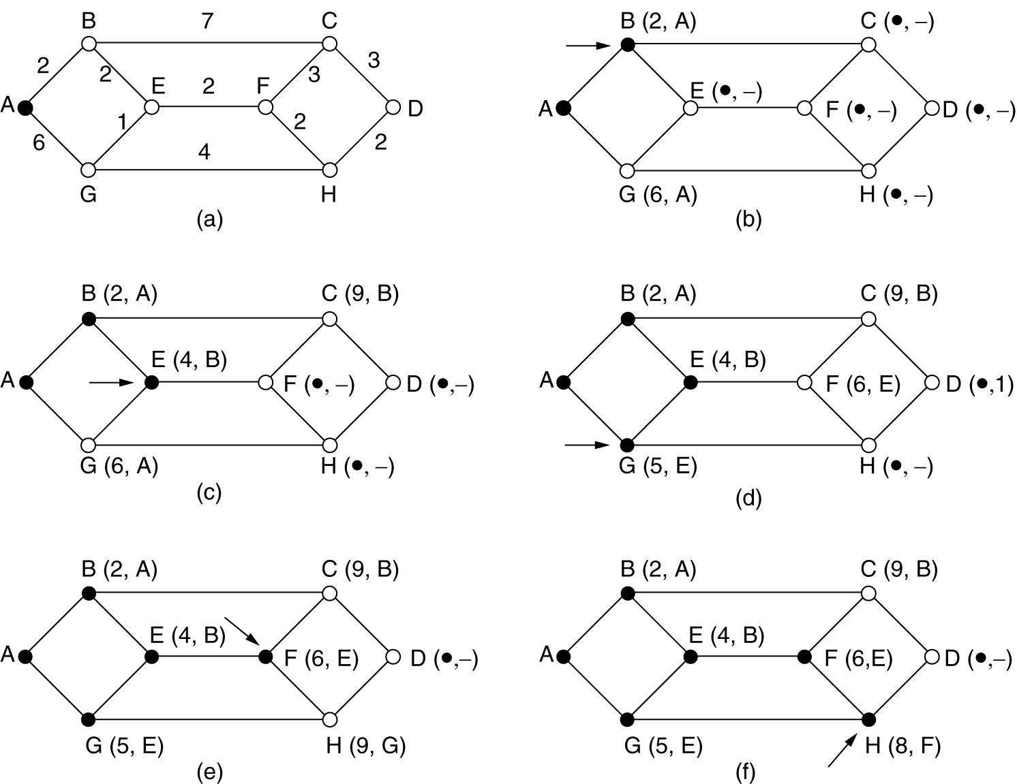
Shortest Path Routing
Dijkstra’s algorithm A→D
The arrows indicate the working node.

Slide 26
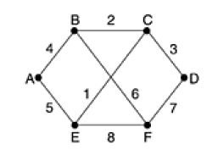
Shortest Path Routing
Apply Dijkstra’s algorithm to find the shortest path from A to D

Slide 27
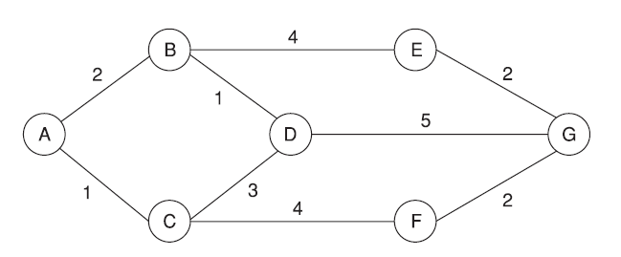
Shortest Path Routing
Apply Dijkstra’s algorithm to find the shortest path from A to G

Slide 28
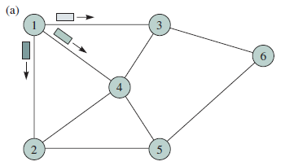
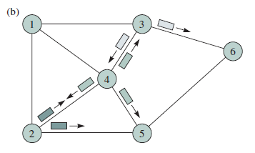
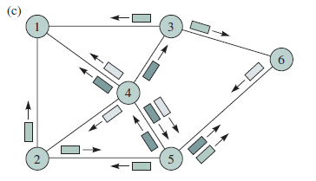
  Flooding ( static algorithm )
Every incoming packet is sent out on every outgoing line except the one it arrived on.
The drawback is that it generates a vast number of duplicate packets.

Slide 29
  Flooding ( static algorithm )
Some measures to avoid duplicate packets.
  Hop Count Method
    A hop counter is included in the header of each packet,
    The counter is decremented at each hop
    when the counter reaches zero ,the packet will be discarded

Slide 30
  Flooding ( static algorithm )
  Sequence number Method
    Source router adds a unique sequence number to each packet.
    When a router receives a packet, the router records the source address and the sequence number.
    if the packet is already seen by the router , then it simply discards the packet.

Slide 31
  Flooding ( static algorithm )
  Selective flooding
    The routers do not send every incoming packet out on every line
    A packet is sent only on those lines that are going approximately in the right direction

Slide 32
  Flooding ( static algorithm )
Applications of flooding
Military
  If a large number of routers are destroyed ,then information can be propagated with the help of flooding .
Distributed database applications
  to update all the databases concurrently
Wireless networks,
  If all messages transmitted by a station can be received by all other stations within its radio range
As a metric against which other routing algorithms can be compared.

Slide 33
Distance Vector Routing
(Bellman, 1957; and Ford and Fulkerson, 1962)
Each router maintains a routing table indexed by, and containing one entry for, each router in the subnet.
This entry contains two parts:
    the preferred outgoing line to use for that destination
    an estimate of the time or distance to that destination.
The router is assumed to know the ''distance'' to each of its neighbors.

Slide 34
Distance Vector Routing
(Bellman, 1957; Ford and Fulkerson, 1962)
Assuming that delay is used as a metric and that the router knows the delay to each of its neighbors, the algorithm works as follows:
  Once every T msec each router sends to each neighbor a list of its estimated delays to each destination. It also receives a similar list from each neighbor.
  Suppose that the router has received from X, X_{i} being X's estimate of how long it takes to get to router i. If the router knows that the delay to X is m msec, it also knows that it can reach router i via X in X_{i} + m msec.
  By performing this calculation for each neighbor, a router can find out which estimate seems the best and use that estimate and the corresponding line

Slide 35
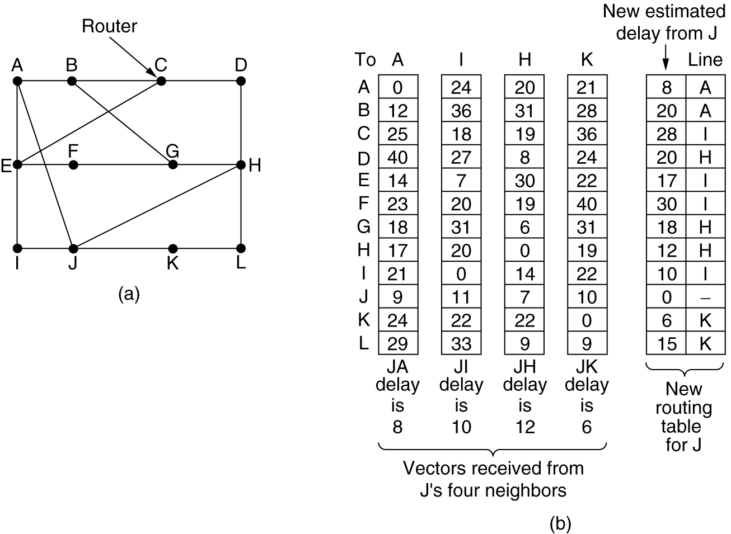
Distance Vector Routing
(Bellman, 1957; Ford and Fulkerson, 1962)
Example
(a) A subnet. (b) Input from A, I, H, K, and the new routing table for J.

Slide 36
Distance Vector Routing
(Bellman, 1957; Ford and Fulkerson, 1962)
The Count-to-Infinity Problem
Distance vector routing has a serious drawback in practice:
Although it converges to the correct answer, it may do so slowly.
    i.e. It reacts very slowly to a link failure.
    (experiencing unstability - 4th property)

Slide 37
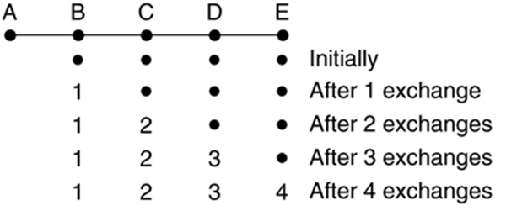
Distance Vector Routing
(Bellman, 1957; Ford and Fulkerson, 1962)
The Count-to-Infinity Problem - Example
Suppose A is down initially and all the other routers have recorded the delay to A as infinity. When A comes up, the other routers learn about it via the vector exchanges.
Reaction to the good news
In a subnet whose longest path is of length N hops, within N exchanges everyone will know about newly-revived lines and routers

Slide 38
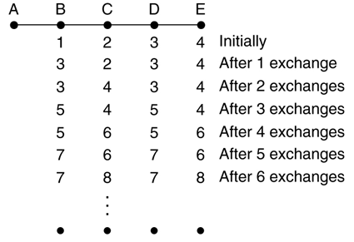
Distance Vector Routing
(Bellman, 1957; Ford and Fulkerson, 1962)
The Count-to-Infinity Problem - Example
Let us consider the situation of in which all the lines and routers are initially up. Routers B, C, D, and E have distances to A of 1, 2, 3, and 4, respectively. Suddenly A goes down, or alternatively, the line between A and B is cut,
Reaction to the bad news

Slide 39
Distance Vector Routing
(Bellman, 1957; Ford and Fulkerson, 1962)
The Count-to-Infinity Problem - Example
At the first packet exchange , B thinks it can reach A via C, with a path length of 3. B does not know that C's path runs through B itself. So it updates its entry with 3 (1+2) to A via C. D and E do not update their entries for A on the first exchange. Similar problem occurs with other nodes in the subsequent exchanges. This continues to infinity at which point routers will come to know that A is down.

Slide 40
Distance Vector Routing
(Bellman, 1957; Ford and Fulkerson, 1962)
Consider the following subnet Distance vector routing is used, and the following vectors have just come in to router C: from B: (5, 0, 8, 12, 6, 2); from D: (16, 12, 6, 0, 9, 10); and from E: (7, 6, 3, 9, 0, 4). The measured delays to B, D, and E, are 6, 3, and 5, respectively. What is C's new routing table? Give both the outgoing line to use and the expected delay.

Slide 41
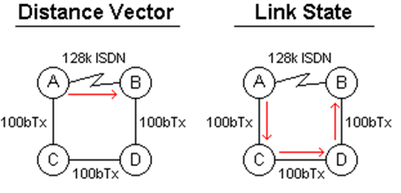
Link State Routing
DV was used in the ARPANET. Two primary problems caused its demise
Count – to – infinity problem
The delay metric was queue length. It did not take line bandwidth into account when choosing routes.
With DV ,the 'route' chosen would be AB ,even though that link is about 10 times slower than the route ACDB.

Slide 42
Link State Routing
The idea behind link state routing is simple. Each router must do the following:
Discover its neighbors and learn their network addresses.
Measure the delay or cost to each of its neighbors.
Construct a packet telling all it has just learned.
Send this packet to all other routers.
Compute the shortest path to every other router

Slide 43
Link State Routing
Learning about the Neighbors
Each router sends a special HELLO packet to each of its neighbors.
A neighbor is expected to reply giving its ID.
These names (IDs) must be globally unique

Slide 44
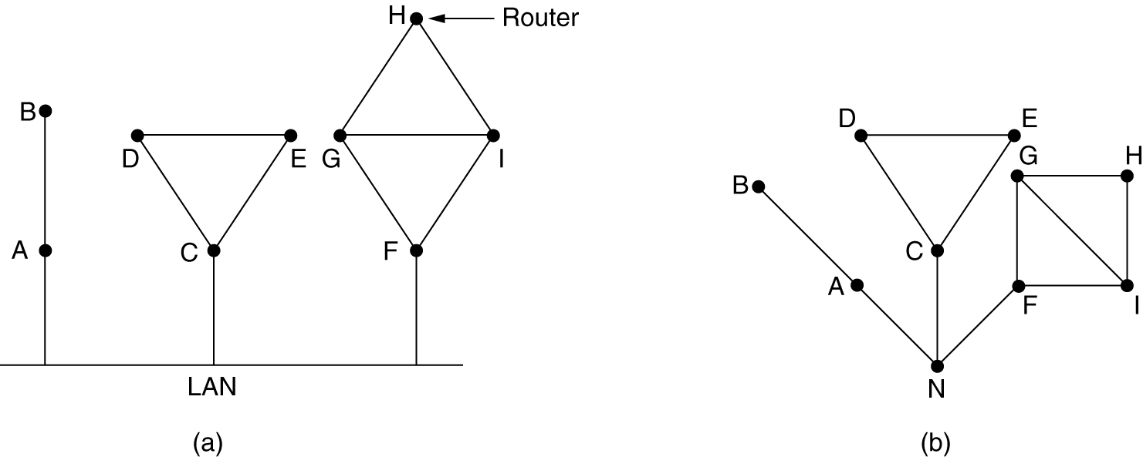
Link State Routing
Learning about the Neighbors
When two or more routers are connected by a LAN, the situation is slightly more complicated. The fact that it is possible to go from A to C on the LAN is represented by the path ANC here
Nine routers and a LAN. (b) A graph model of (a).

Slide 45
Link State Routing
Measuring Line Cost
A special ECHO packet is sent to each neighbour and other side is required to send back immediately
RTT is measured to get a reasonable delay to each of its neighbours.
    delay = RTT / 2 ;

Slide 46
Link State Routing
Measuring Line Cost
Whether to take the load into account when measuring the delay ?
  If taken into account , the round-trip timer must be started when the ECHO packet is queued.
  To ignore the load, the timer should be started when the ECHO packet reaches the front of the queue

Slide 47
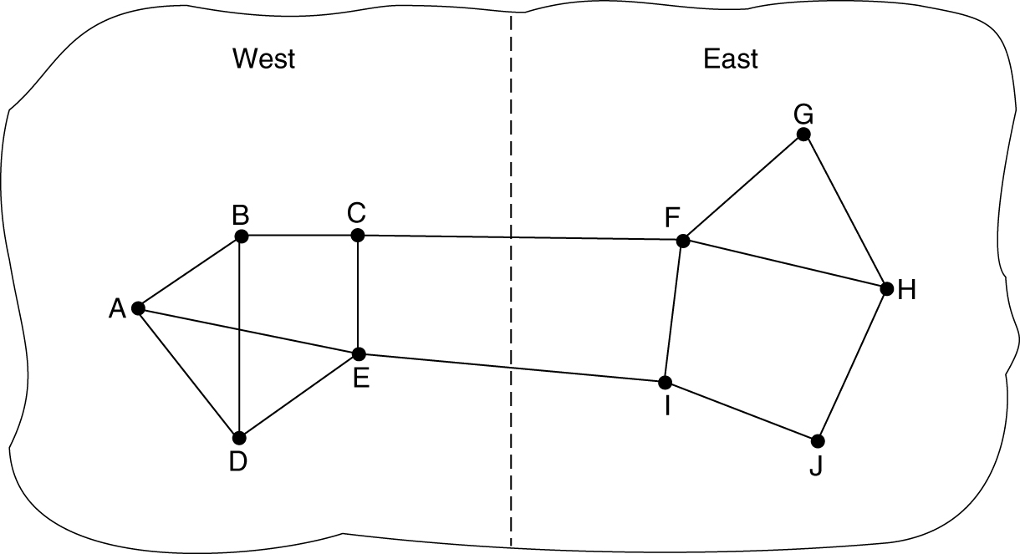
Link State Routing
Measuring Line Cost
Including load in the delay measurements may cause routing tables to oscillate wildly, leading to erratic routing and many potential problems.
If load is ignored and only bandwidth is considered, this problem does not occur.

Slide 48
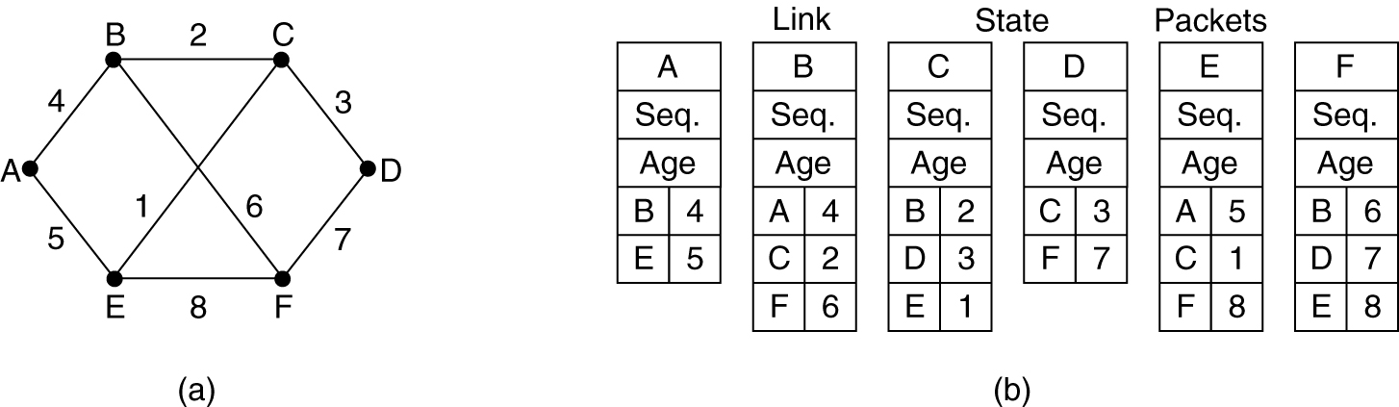
Link State Routing
Building Link State Packets
The next step is for each router to build a packet containing all the data
The packet starts with the identity of the sender, followed by a sequence number and age , and a list of neighbors
A subnet. (b) The link state packets for this subnet.

Slide 49
Link State Routing
Distributing the Link State Packets
Basic distribution algorithm is flooding to distribute Link State Packets.
To keep flood in check, packet sequencing method (2nd method ) can be used
  Each new packet is given a sequence number
  At every router , If packet is new, it is forwarded on all lines except the one it arrived on. If it is a duplicate, it is discarded.

Slide 50
Link State Routing
Distributing the Link State Packets
Some issues in distributing LSPs
  What if the sequence numbers wrap around?
    the next packet will be rejected as a duplicate
  What if a router ever crashes ?
    it will lose track of its sequence number.
    If it starts again at 0, the next packet will be rejected as a duplicate
  What if a sequence number is ever corrupted ?
    if 65,540 is received instead of 4 (a 1-bit error), packets 5 through 65,540 will be rejected as obsolete

Slide 51
Link State Routing
Distributing the Link State Packets
Solutions
  Use 32 bit sequence number.
  The solution to 2nd and 3rd problems is to include the Age of each packet after the sequence number and decrement it once per second. When the age hits zero, the information from that router is discarded.

Slide 52
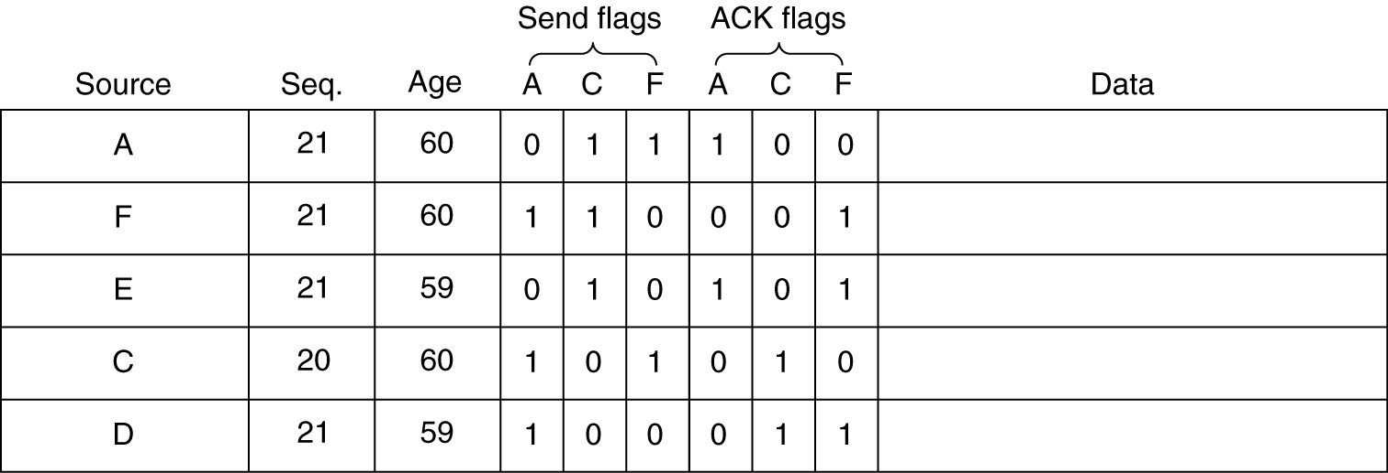
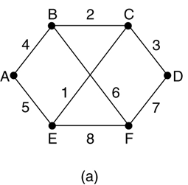
Link State Routing
Distributing the Link State Packets
An example of data structure used by router B for the subnet shown below. Each row here corresponds to a recently-arrived, but as yet not fully-processed, LSP
Table used by router B

Slide 53
Link State Routing
Distributing the Link State Packets
Note
The link state packet from A arrives directly, so it must be sent to C and F and acknowledged to A, as indicated by the flag bits.
The situation with the third packet, from E, is different. It arrived twice, once via EAB and once via EFB, Consequently, it has to be sent only to C but acknowledged to both A and F
If a duplicate arrives while the original is still in the buffer, bits have to be changed

Slide 54
Link State Routing
Computing the New Routes
Once a router has accumulated a full set of link state packets, it can construct the entire subnet graph because every link is represented
Now Dijkstra's algorithm can be run locally to construct the shortest path to all possible destinations.
The results of this algorithm can be installed in the routing tables, and normal operation resumed.

Slide 55
Link State Routing
Things can go wrong if
  hardware or software failure occurs .
  If a router fails to forward packets or corrupts them while forwarding them
  if it runs out of memory or does the routing calculation wrong
Examples :
OSPF (Open Shortest Path First) routing - used The Internet
IS-IS (Intermediate System-Intermediate System), - used in DECnet

Slide 56
Hierarchical Routing
Why Hierarchical Routing ?
As networks grow in size, the router routing tables grow proportionally
At a certain point, it may not feasible for every router to have an entry for every other router.
So the routing will have to be done hierarchically

Slide 57
Hierarchical Routing
The routers are divided into regions
Each router knows how to route packets to destinations within its own region, but knows nothing about the internal structure of other regions
For huge networks , it may be necessary to group the regions into clusters, the clusters into zones, the zones into groups, and so on,

Slide 58
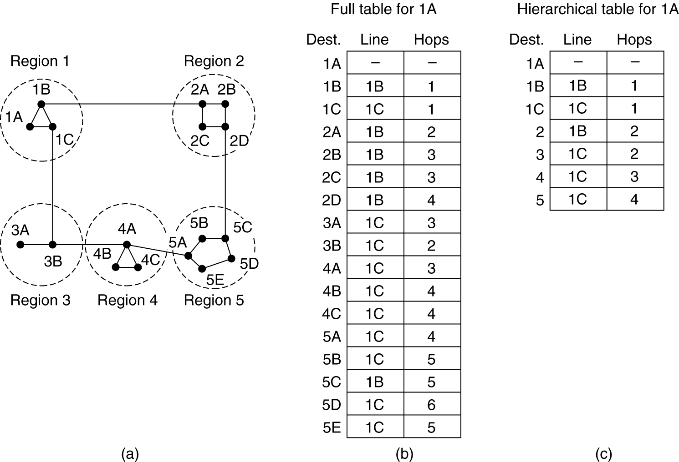
Hierarchical Routing
Example : A two-level hierarchy with five regions.
With hierarchal routing a table would require only 7 entries
Without hierarchal routing a table would require 17 entries

Slide 59
Hierarchical Routing
Note :
The full routing table for router 1A has 17 entries, as shown . When routing is done hierarchically, 1A has 7 entries
The disadvantage of Hierarchical Routing can easily be seen from figure. The best route from 1A to 5C is via region 2, but with hierarchical routing all traffic to region 5 goes via region 3
it is discovered that the optimal number of levels for an N router subnet is ln N

Slide 60
Broadcast Routing
Sending a packet to all destinations simultaneously is called broadcasting
Techniques for broadcasting:
    Simple Broadcasting
    Flooding
    Multi - destination routing
    Spanning tree method
    Reverse path forwarding

Slide 61
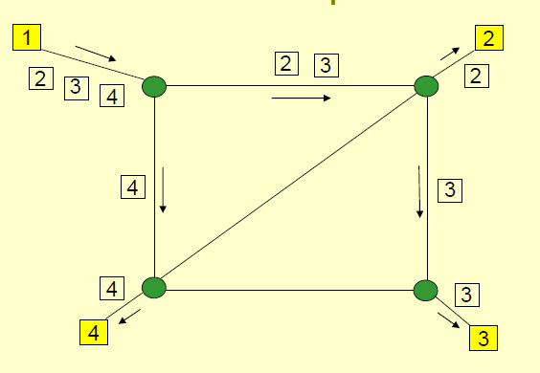
Broadcast Routing
  Simple Broadcasting :
    send a distinct packet to each destination
      wastes of bandwidth
      source should have a complete list of all destinations

Slide 62
Broadcast Routing
  Flooding :
    It generates too many packets
    So consumes too much bandwidth.

Slide 63
Broadcast Routing
Multi-destination routing :
  Each packet contains a list of destinations .
  When a packet arrives at a router, the router checks all the destinations to determine the set of output lines that will be needed.
  The router generates a new copy of the packet for each output line to be used and includes in each packet only those destinations that are to use the line.
  After a sufficient number of hops, each packet will carry only one destination and can be treated as a normal packet.

Slide 64















Broadcast Routing
Multi-destination routing Example - 1
B
C
D
BCDEFGHI
E
A
F
G

Slide 65
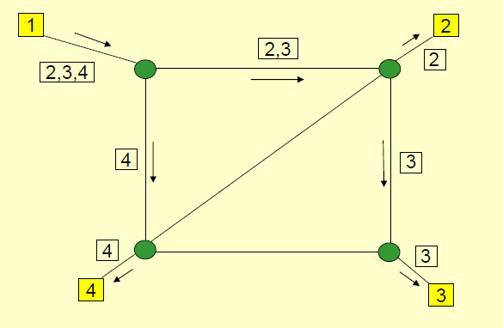
Broadcast Routing
Multi-destination routing :
Example - 2

Slide 66
Broadcast Routing
spanning tree method (sink tree) :
  If each router knows which of its lines belong to the spanning tree, it can copy an incoming broadcast packet onto all the spanning tree lines except the one it arrived on.
      Minimum number of packets necessary to do the job
      So makes excellent use of bandwidth,
      Each router must have knowledge of some spanning tree

Slide 67
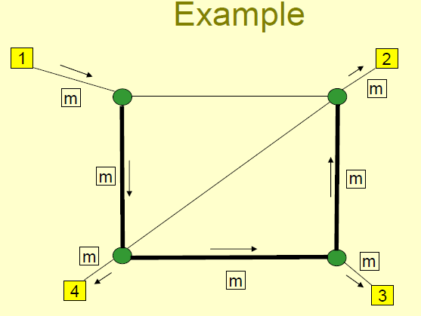
Broadcast Routing
spanning tree method (sink tree) :
5
4
1
3
2

Slide 68
Broadcast Routing
Reverse path forwarding:
    When a broadcast packet arrives at a router, the router checks to see if the packet arrived on the optimal path to the source .
    If so, the broadcast packet itself followed the best route from the router and is therefore the first copy to arrive at the router. the router forwards copies of it onto all lines except the one it arrived on.
    If, however, the broadcast packet has not arrived on the preferred one for reaching the source, the packet is discarded as a likely duplicate.

Slide 69
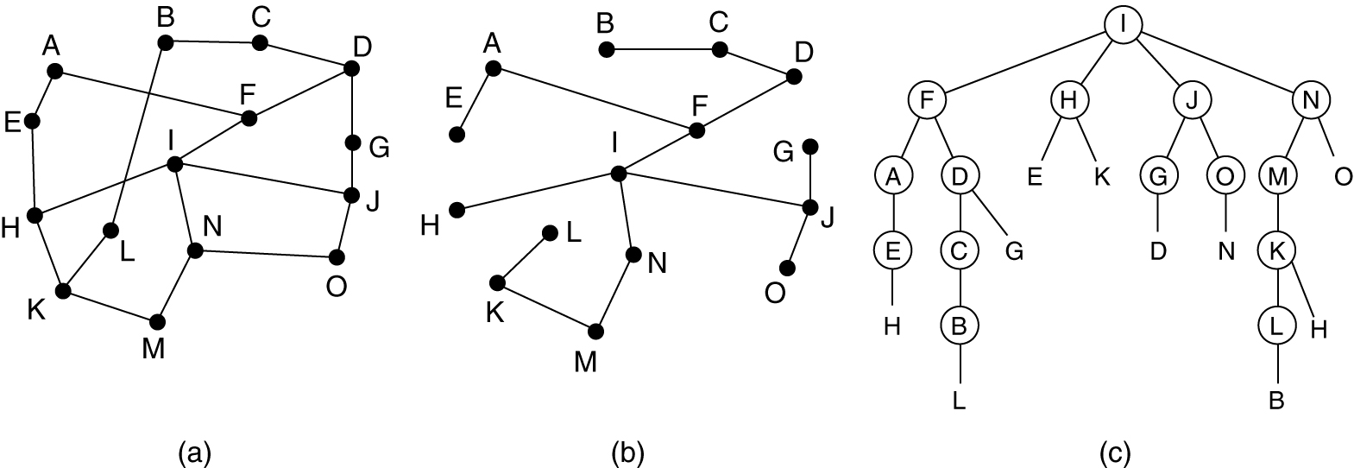
Broadcast Routing
Reverse path forwarding: Example
(a) shows a subnet, part (b) shows a sink tree for router I of that subnet, and part (c) shows how the reverse path algorithm works.

Slide 70
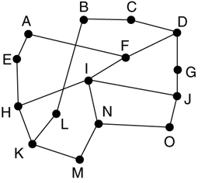
Broadcast Routing
Consider the following subnet. The router N wants to broadcast a packet using Reverse Path Forwarding algorithm. Show the tree built by reverse path forwarding.

Slide 71
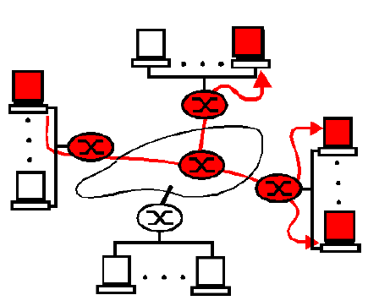




Multicast Routing
Sending a message to a group is called multicasting, and its routing algorithm is called multicast routing.
Belongs to multicast group
Does not Belong to multicast group
Involved in multicasting
Not Involved in multicasting

Slide 72
Multicast Routing
Group Management
  i.e. create ,destroy groups, allow processes to join and leave groups
  It is important that routers know which of their hosts belong to which groups
  Routers tell their neighbors about this, so the information propagates through the subnet.

Slide 73
Multicast Routing
How multicasting is achieved ?
  Find a tree (MST) of links that connects all of the routers that have attached hosts belonging to the multicast group.
  Multicast packets will then be routed along this tree from the sender to all of the hosts belonging to the multicast tree.

Slide 74
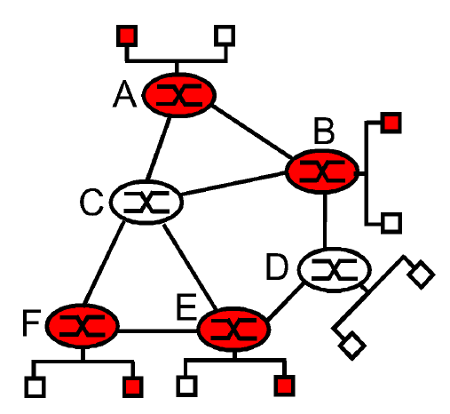
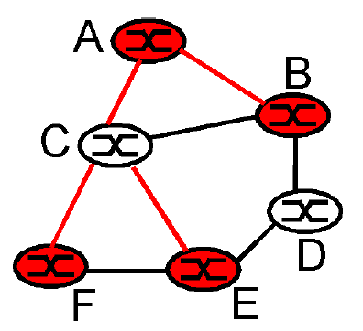
Multicast Routing
How multicasting is achieved ?
  The tree may contain routers that do not have attached hosts belonging to the multicast group. (it is impossible to connect routers A, B, E, and F in a tree without involving either routers C and/or D
Multicast tree (MST)

Slide 75
Multicast Routing
Two approaches for multicasting.
  Group-shared tree
    Only a single routing tree is constructed for the entire multicast group.
    Multicast packets will then be routed along this tree
  Source-based trees
    An individual routing tree is constructed for each sender in the multicast group.
    Packets will be routed to multicast group members in a source-specific manner

Slide 76
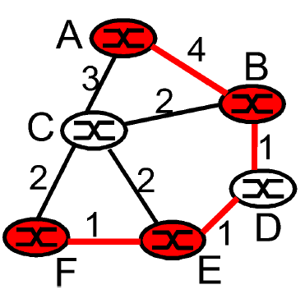
Multicast Routing
Group-shared tree
  Only a single routing tree (MST) is constructed for the entire multicast group.
Multicast tree (MST)

Slide 77
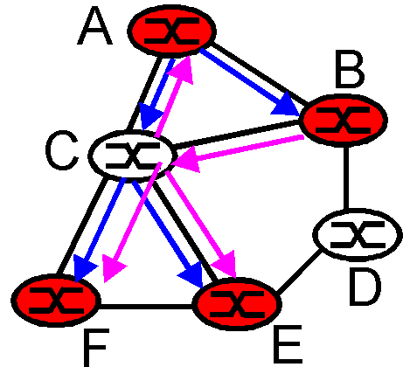
Multicast Routing
Source-based trees : An individual routing tree is constructed for each sender in the multicast group
Multicast tree (MST) for A & B

Slide 78
Multicast Routing
How Source-based method works?
Each router computes a spanning tree (sink tree) covering all other routers.
When a process sends a multicast packet to a group, the first router examines its spanning tree prunes it, removing all lines that do not lead to hosts that are members of the group.

Slide 79
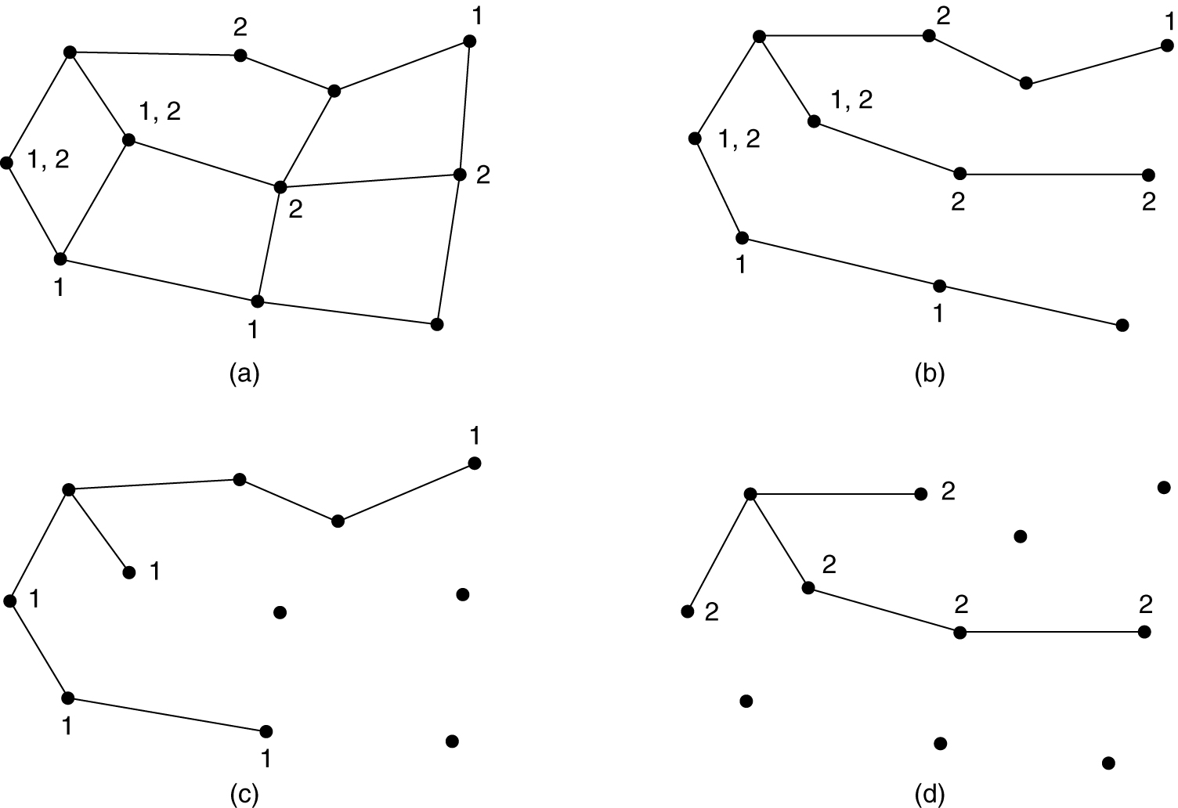
Multicast Routing
Pruning spanning tree
(a) A network. (b) A spanning tree for the leftmost router. (c) A multicast tree for group 1. (d) A multicast tree for group 2.

Slide 80
Multicast Routing
Pruning Methods:
If link state routing is used
  Each router is aware of the complete topology.
  Then the spanning tree can be pruned, starting at the end of each path, working toward the root, and removing all routers that do not belong to the group in question

Slide 81
Multicast Routing
Pruning Methods:
If Distance Vector routing is used , reverse path forwarding can be used.
  A multicast router that receives multicast packets and has no attached hosts joined to that group will send a PRUNE message to its upstream router.
  If a router receives prune messages from each of its downstream routers, then it can forward a prune message upstream

Slide 82
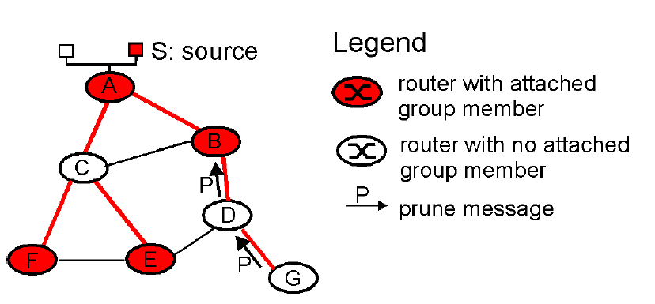
Multicast Routing
Pruning Methods:
reverse path forwarding pruning

Slide 83
Multicast Routing
Some Applications :
  the transfer of a software upgrade from the software developer to users needing the upgrade
  the transfer of the audio, video and text of a live lecture to a set of distributed lecture participants
  a whiteboard or teleconferencing application that is shared among many distributed participants
  multiplayer games such as Quake

Slide 84
Routing for Mobile Hosts
Home location :
  All mobile hosts are assumed to have a permanent home location that never changes.
Home address :
  Hosts also have a permanent home address that can be used to determine their home locations
Area :
  typically a LAN or wireless cell.
Foreign agents :
  processes that keep track of all mobile hosts visiting the area
Home agent:
  keeps track of hosts whose home is in the area, but who are currently visiting another area.

Slide 85
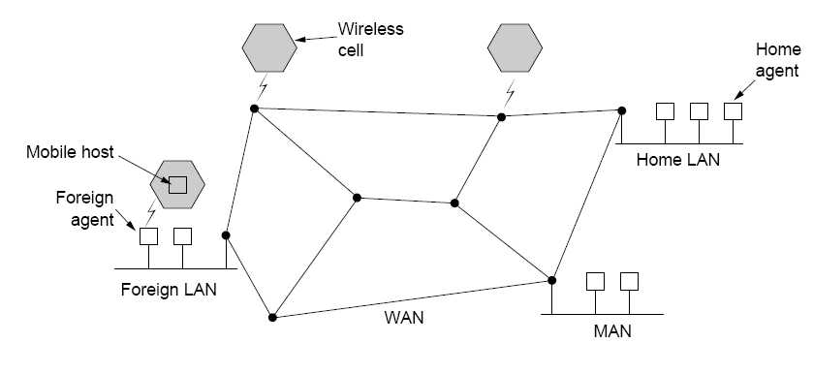
Routing for Mobile Hosts
The model for Mobile Host Network

Slide 86
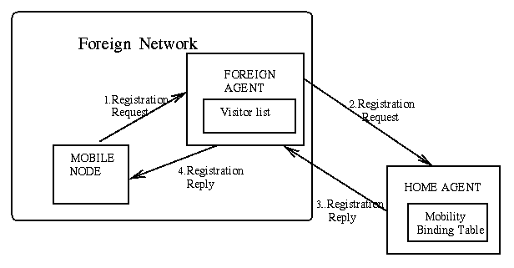
Routing for Mobile Hosts
When a new host enters an area, it must register itself with the foreign agent there as shown below

Slide 87
Routing for Mobile Hosts
The registration procedure typically works like this:
  Periodically, each foreign agent broadcasts a packet announcing its existence and address. Mobile host must wait for one of these packets.
  When the host receives a packet it knows that a foreign agent exists. The mobile host registers with the foreign agent, giving its home address, current data link layer address, and some security information.
  The foreign agent contacts the mobile host's and sends home agent foreign agent's network address. It also includes the security information.
  The home agent examines the security information, which contains a timestamp
  When the foreign agent gets the acknowledgement from the home agent, it makes an entry in its tables and informs the mobile host that it is now registered.

Slide 88
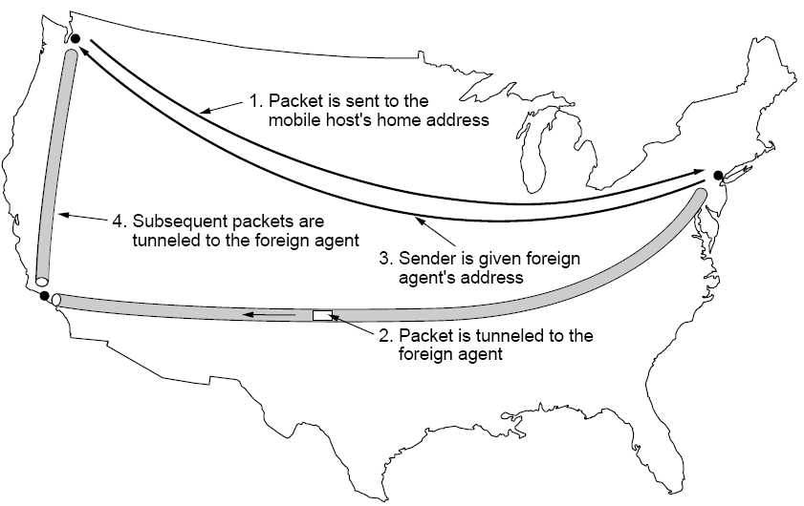
Routing for Mobile Hosts
Steps in routing for mobile hosts
sender
Home LAN
Mobile host at some foreign LAN

Slide 89
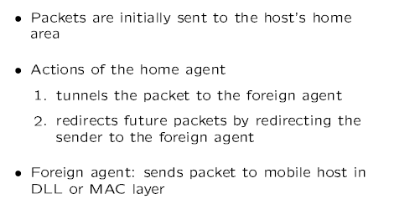
Routing for Mobile Hosts
Steps in routing for mobile hosts

Slide 90
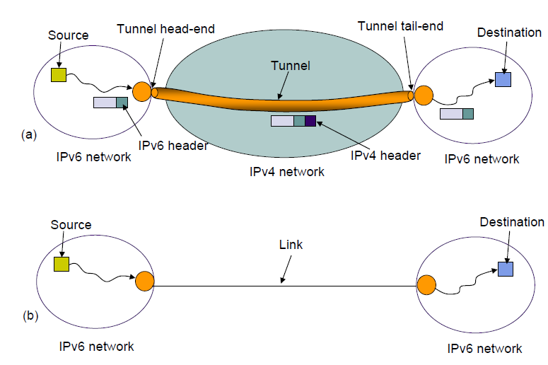
What is tunneling ?
A tunnel is a path created between two nodes (across the network) so that the tunnel appears as a single link. A tunneling approach hides the root taken by the tunnel from the user .

Slide 91
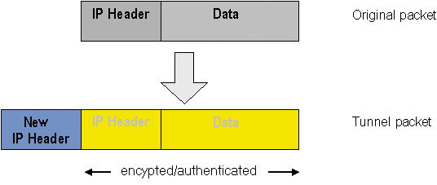
What is tunneling ?
A tunneling is typically encapsulating a network layer packet inside another network layer packet.

Slide 92
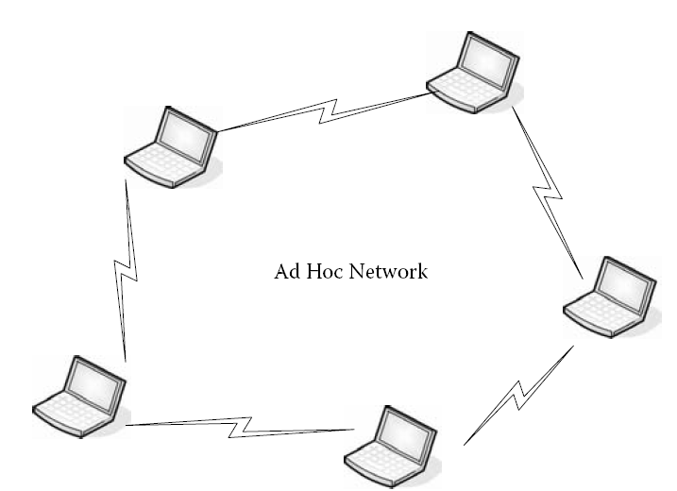
Routing in Ad Hoc Networks
(MANETs - Mobile Ad hoc Networks.)
What is an adhoc network?
An ad hoc network is a collection of wireless mobile nodes dynamically forming a temporary network without the use of any existing network infrastructure or centralized administration.
Each node consists of a router and a host

Slide 93
Routing in Ad Hoc Networks
(MANETs - Mobile Ad hoc Networks.)
Routing in ad hoc networks is quite different, because
  Topology is not fixed
  No fixed and known neighbours
  No fixed relationship between IP address and location
Various routing algorithms have been proposed , we discuss one of them ;
  - AODV (Ad hoc On-demand Distance Vector)
  - proposed by Perkins and Royer, 1999.

Slide 94
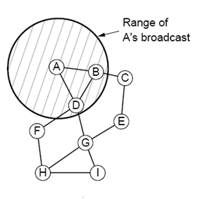
Routing in Ad Hoc Networks - AODV
Two nodes are connected , if they can communicate directly.
Each node’s routing table is similar to routing table in DV algorithm

Slide 95
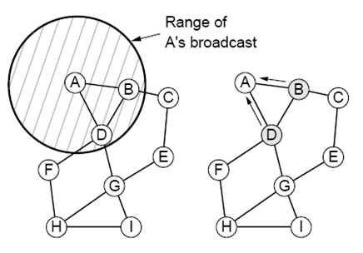
Route Discovery in AODV:
Suppose that node A wants to send a packet to node. Suppose that A looks in its table and does not find an entry for I. It now has to discover a route to I.
To locate I, A constructs a ROUTE REQUEST packet and broadcasts it.

Slide 96

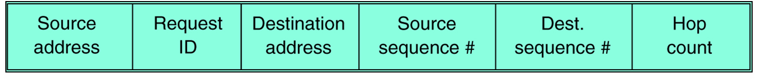
Route Discovery in AODV:
Format of a ROUTE REQUEST packet.
uniquely identify the ROUTE REQUEST Packet
Request ID → A local counter maintained separately by each node and incremented each time a ROUTE REQUEST is broadcast.
source sequence → A's sequence counter in this case
Dest. Sequence→ the most recent value of I's sequence number that A has seen .
Hop count → keeps track of how many hops the packet has made

Slide 97
Route Discovery in AODV:
When a ROUTE REQUEST packet arrives at a node it is processed as follows
  if it is a duplicate , discard it and stop processing. Otherwise store (Source address, Request ID) pair.
  Look up the destination in the route table for a fresh route.
  If a fresh route is found then;
  send a ROUTE REPLY packet back to the source.
  ( To inform about the fresh root.)
  Otherwise goto step 3;

Slide 98
Route Discovery in AODV:
  Extract the data from the packet and stores it as a new entry in its reverse route table to build reverse route later,
  increment the Hop count field and rebroadcast the ROUTE REQUEST packet.
Note :
Fresh route means that the Destination sequence number stored in the routing table is greater than or equal to the Destination sequence number in the ROUTE REQUEST packet)

Slide 99
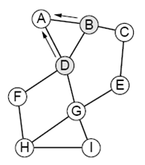
Route Discovery in AODV:
  Making reverse route entry in the reverse route table
Neither B nor D knows where I is, so each of them creates a reverse route entry pointing back to A, as shown by the arrows in Figure and broadcasts the packet with Hop count set to 1.

Slide 100
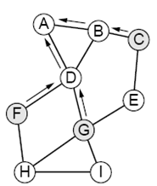
Route Discovery in AODV:
  Making reverse route entry in the reverse route table
The broadcast from B reaches C and D. C makes an entry for it in its reverse route table and rebroadcasts it. In contrast, D rejects it as a duplicate. Similarly, D's broadcast is rejected by B. However, D's broadcast is accepted by F and G and stored

Slide 101
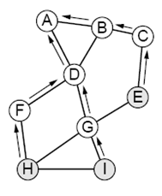
Route Discovery in AODV:
  Making reverse route entry in the reverse root table
After E, H, and I receive the broadcast, the ROUTE REQUEST finally reaches a destination I. I builds a ROUTE REPLY packet and sends to G. The packet follows the path I->G->D->A.

Slide 102
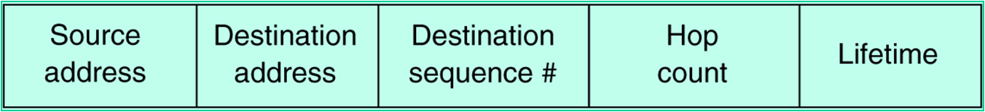
Route Discovery in AODV:
Format of ROUTE REPLY packet.
The Source address, Destination address, and Hop count are copied from the incoming request, but the Destination sequence number taken from its counter in memory. Hop count field is set to 0. The Lifetime field controls how long the route is valid

Slide 103
Route Discovery in AODV:
At each intermediate node on the way back to A , the packet is inspected. It is entered into the local routing table as a route to I if one or more of the following three conditions are met:
    No route to I is known.
    The sequence number for I in the ROUTE REPLY packet is greater than the value in the routing table.
    The sequence numbers are equal but the new route is shorter.
In this way, all the nodes on the reverse route learn the route to I for free.

Slide 104
Route Maintenance
Because nodes can move or be switched off, the topology can change spontaneously. The algorithm deals with this as follows:
  Periodically, each node broadcasts a Hello message.
  Each of its neighbors is expected to respond to it.
  If no response is forthcoming, the broadcaster knows that that neighbor is out of range.
  Similarly, if it tries to send a packet to a neighbor that does not respond, learns that the neighbor is no longer available.
  This information is used to purge(remove) routes that no longer work

Slide 105
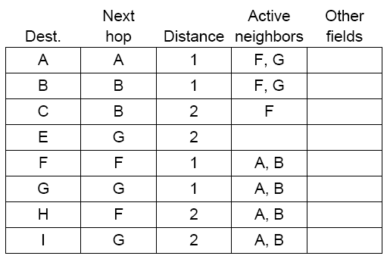
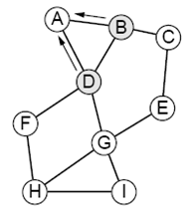
Route Maintenance : how is it done?
For each possible destination, each node, N, keeps track of its neighbors that have fed it a packet for that destination during the last T seconds. These are called N's active neighbors for that destination.
D's routing table before G goes down

Slide 106
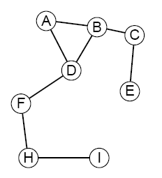
Route Maintenance : how is it done?
Suppose that G goes down
The graph after G has gone down.

Slide 107
Route Maintenance : how is it done?
Suppose that G goes down
The graph after G has gone down.
When D discovers that G is gone, it looks at its routing table and sees that G was used on routes to E, G, and I. A and B depend on G for some of their routes, so they have to be informed that these routes no longer work. After it tells this , A and B update their own routing tables accordingly. D also purges the entries for E, G, and I from its routing table.

Slide 108
Route Maintenance : how is it done?
Suppose that G goes down
The graph after G has gone down.
Similarly A and B inform their neighbors about this. The neighbors update their routing tables accordingly. This continues recursively until all routes depending on G are purged from all routing tables.

